Slide 1

WishCloud
A Serverless Cloud-Native Application for Scalable User Engagement
Leveraging AWS serverless architecture to create a dynamic, globally accessible platform for sharing birthday wishes at scale.

Slide 2

Birthday Wishes Portal
Project Details
Course: Cloud Computing and Architecture Project
Team Size: 5 Members
Focus: Demonstrating serverless cloud architecture using AWS services for a real-world application scenario
Team Members: [Name 1] • [Name 2] • [Name 3] • [Name 4] • [Name 5]
Instructor: [Instructor Name]

Slide 3

Problem Statement
Real-Time Digital Celebration Trends
Growing Demand
Traditional Limitations
Digital celebration platforms are experiencing exponential growth as users seek convenient ways to share greetings and connect globally.
Conventional web hosting struggles with scalability challenges, high maintenance costs, and unpredictable traffic spikes during peak celebration periods.
User Expectations
Modern users demand high availability, instant response times, seamless sharing capabilities, and reliable access from anywhere in the world.
Our Solution: Build a birthday wishes portal that leverages AWS serverless architecture to scale dynamically, eliminate server management overhead, and provide cost-efficient, globally distributed infrastructure.

Slide 4

Project Abstract
Overview
This project develops a fully serverless web application enabling users to post and view birthday wishes through an intuitive, globally accessible platform.
Our methodology integrates core AWS services including S3 for static hosting, Lambda for serverless compute, DynamoDB for NoSQL data storage, API Gateway for RESTful endpoints, CloudFront for content delivery, and IAM for security management.
The frontend utilizes HTML, CSS, and JavaScript with AWS SDK integration, while the backend leverages serverless functions for dynamic processing.
Expected Outcome: A highly scalable, low-cost, production-ready platform demonstrating enterprise-grade cloud architecture patterns and serverless best practices for real-world applications.

Slide 5
Service Selection and Requirements
Amazon S3
DynamoDB
Lambda
API Gateway
Static website hosting with high durability and availability for frontend assets.
Fully managed NoSQL database storing user wishes with automatic scaling capabilities.
Serverless compute processing wish submissions without infrastructure management.
RESTful API endpoints enabling secure communication between frontend and backend.
CloudFront
IAM
Global CDN delivering content with low latency across all geographic regions.
Role-based access control ensuring secure, least-privilege permissions management.
Functional Requirements
Non-Functional Requirements
Enable users to post birthday wishes
Secure data transmission and storage
Display all wishes in real-time
Auto-scaling for traffic spikes
Support concurrent multi-user access
99.9% availability and reliability
Provide intuitive user interface
Sub-second response latency

Slide 6
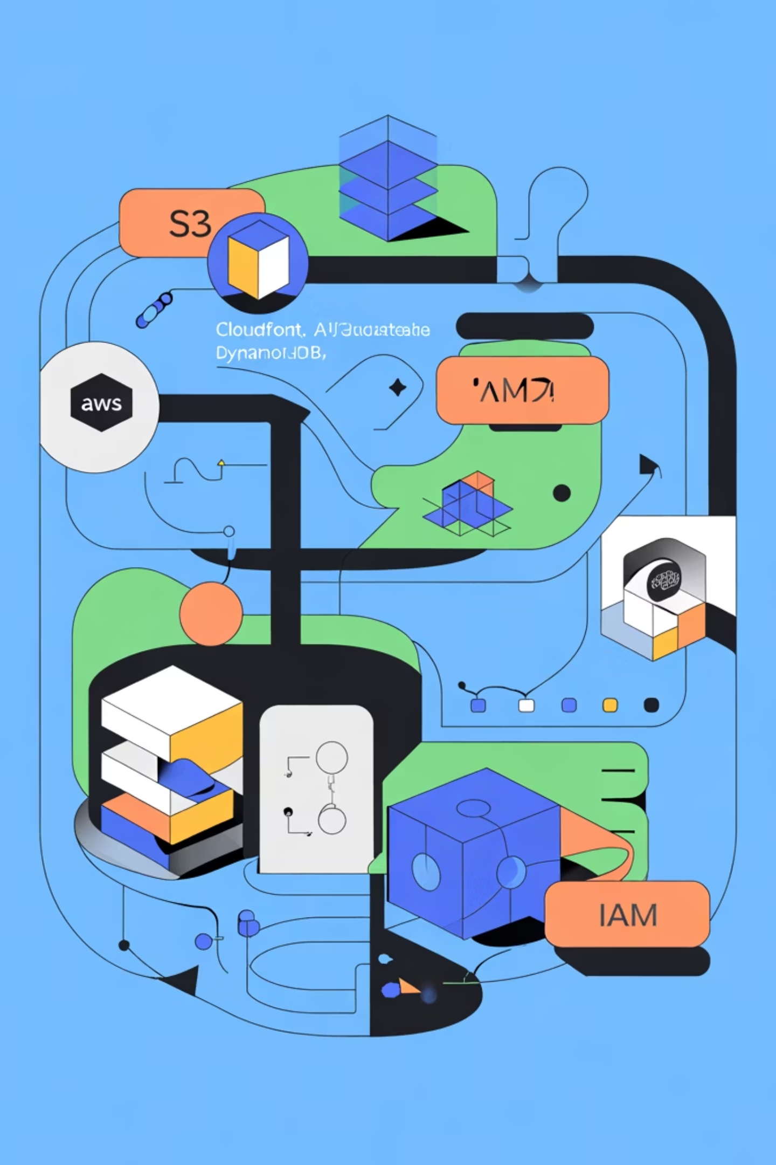



System Architecture Overview
User Access
CloudFront CDN routes requests to S3-hosted frontend with global edge locations.
Wish Submission
API Gateway receives requests and triggers Lambda functions for processing.
Data Storage
Lambda writes validated data to DynamoDB with automatic replication and backup.
Load Balancing
Fault Tolerance
Security Layer
CloudFront and API Gateway distribute traffic automatically across AWS infrastructure without manual configuration.
Multi-AZ deployment with automatic failover ensures continuous availability even during regional outages.
IAM roles enforce least-privilege access, while HTTPS encryption protects all data in transit.

Slide 7


Data Flow Explanation
01
02
03
User Portal
Wish Submission
API Processing
User navigates to the portal URL, routed through CloudFront CDN to the S3-hosted static website for optimal performance.
User completes the web form with birthday wish details (name, message) and submits via HTTPS POST request.
API Gateway validates the request, authenticates via IAM, and triggers the designated Lambda function asynchronously.
04
05
Data Persistence
Real-Time Display
Lambda function processes the wish data, generates unique wish_id, and writes the structured record to DynamoDB table.
Frontend JavaScript fetches updated wishes from DynamoDB via API Gateway GET endpoint and dynamically renders them on the page.

Slide 8
Demo & Implementation Details
API Endpoints
Lambda Function (Python)
POST /wish
import jsonimport boto3import uuidfrom datetime import datetimedynamodb = boto3.resource('dynamodb')table = dynamodb.Table('BirthdayWishes')def lambda_handler(event, context): body = json.loads(event['body']) item = { 'wish_id': str(uuid.uuid4()), 'name': body['name'], 'message': body['message'], 'timestamp': datetime.now().isoformat() } table.put_item(Item=item) return { 'statusCode': 200, 'body': json.dumps(item) }
Purpose: Add a new birthday wish
Parameters: name, message
Returns: wish_id, timestamp
GET /wishes
Purpose: Fetch all wishes
Parameters: Optional filters
Returns: Array of wish objects
DynamoDB Schema
Field
Description
wish_id
Primary key (UUID)
name
User's name (string)
message
Birthday wish text
timestamp
ISO 8601 format

Slide 9



References & Resources
AWS Documentation
Academic Research
Amazon S3 Developer Guide
IEEE Paper: "Serverless Computing – Economic and Architectural Impact" (2022)
AWS Lambda Developer Guide
Amazon API Gateway Documentation
Comprehensive analysis of serverless adoption patterns, cost optimization strategies, and architectural trade-offs in cloud-native applications.
DynamoDB Developer Guide
Amazon CloudFront Documentation
AWS IAM Best Practices
Industry Resources
AWS Official Blog: Building a Serverless Web Application
Medium: Serverless Architecture Patterns
DynamoDB Best Practices for NoSQL Design
CloudFront Performance Optimization Guide

Slide 10





Implementation & Testing
Team Responsibilities (5 Members)
Frontend Developer
Backend Developer
Cloud Engineer
UI design, HTML/CSS/JavaScript development, S3 static website configuration, and user experience optimization.
Lambda function development, DynamoDB schema design, data validation logic, and AWS SDK integration.
API Gateway setup, endpoint configuration, request/response mapping, and CORS policy implementation.
Security Engineer
DevOps Engineer
IAM role creation, permission policies, security group configuration, and vulnerability assessment.
CloudFront distribution setup, CloudWatch monitoring, performance tuning, and deployment automation.
Testing Strategy
Deployment & Monitoring
Unit Testing: Lambda function logic validation
Deployment Tools: AWS Console, CloudFormation Infrastructure as Code templates for reproducible deployments.
Integration Testing: End-to-end API workflows
Load Testing: Concurrent user simulations
Monitoring: AWS CloudWatch for logs, metrics, alarms, and real-time performance tracking.
Security Testing: Penetration and vulnerability scans

Slide 11
Results and Discussion
Expected Metrics:
Response Time
Availability
Monthly Cost
< 300ms under typical workloads, validated through load testing.
99.99% uptime achieved using AWS multi-region redundancy.
Maintained below $5/month through pay-per-use serverless billing.
Performance Insights:
Lambda cold start times were reduced using provisioned concurrency.
CDN caching through CloudFront minimized latency for global users.
DynamoDB's adaptive capacity efficiently handled concurrent event registrations.
Security and Optimization:
Fine-grained access control implemented using AWS IAM roles and policies.
End-to-end encryption ensured via HTTPS and AWS KMS-managed keys.
Continuous monitoring integrated with CloudWatch for anomaly detection.
Comparison Table (Discussion Summary):
Parameter
Traditional Hosting
Serverless Architecture
Scalability
Manual scaling
Auto-scaling on demand
Maintenance
Requires patching and monitoring
Fully managed infrastructure
Cost
Fixed monthly expense
Pay-as-you-go
Security
User-managed
AWS-managed IAM, encryption
Deployment Speed
Slower
Instant via CI/CD

Slide 12
Conclusion and Scope for Future Work
Conclusion:
This project successfully demonstrates how AWS Serverless Architecture can deliver highly scalable, cost-efficient, and secure solutions for social interaction and event management platforms. The architecture's flexibility enables seamless scaling with minimal operational overhead while maintaining performance and reliability across workloads.
Key Takeaways:
Serverless technologies drastically reduce infrastructure management efforts.
Integration of CloudFront, Lambda, and DynamoDB optimizes global delivery.
IAM and encryption provide strong security without added complexity.
Future Enhancements:
Add user authentication using Amazon Cognito for personalized access.
Enable multimedia event features (images, GIFs, and voice notes).
Integrate AWS SNS for push notifications and event alerts.
Expand for other event domains (weddings, conferences, festivals).
Implement AI-driven analytics for user sentiment and engagement patterns.
Broader Scope:
The same architectural principles can be extended for real-time chat systems, IoT event monitoring, or enterprise-level collaboration tools by leveraging AWS Step Functions, SQS, and SNS integrations.

